Slide 1
Unlocking
European-level
HPC Support
This project has received funding from the European High-Performance Computing Joint Undertaking under grant agreement No.101139786.

Slide 2
Context
Mission
Main Goals
Expected Outcomes
Support Services
Access the Resources
Consortium

Slide 3
Context
HPC has enabled technologies with a positive impact on society
More precise climate and weather modelling
Reduced healthcare research costs through simulation
Planning and yield prediction of renewable energy resources
Train larger and more complex Artificial Intelligence models
…
Installation of supercomputers in multiple countries reflects a commitment to HPC's technological potential
EuroHPC JU has been instrumental in elevating European supercomputing

Slide 4
Context
3
Pre-Exascale
5
Petascale
2
Future Exascale
LEONARDO
KAROLINA
JUPITER
LUMI
VEGA
JULIO VERNE
MARE NOSTRUM 5
MELUXINA
DISCOVERER
DEUCALION

Slide 5
Context
Mission
Main Goals
Expected Outcomes
Support Services
Access the Resources
Consortium

Slide 6
Mission
EPICURE draws on the experience and knowledge of the current and future EuroHPC supercomputer hosting organisations to provide better user support
Adequate code installation and porting to different architectures (Level 2)
Intra- and inter-node optimisation, focusing on accelerators and scalability (Level 3)
Knowledge exchange through the organisation of hardware-specific training,, hackathons,, webinars, and workshops in several EU countries
Promotes sharing of expertise among hosting organisations
Provides users with a wide knowledge pool

Slide 7
Context
Mission
Main Goals
Expected Outcomes
Support Services
Access the Resources
Consortium

Slide 8
Main Goals
To establish a four-year operation of a distributed European-wide high-performance computing application support service bringing together Application Support Teams (ASTs);
To reach a large pool of EuroHPC users;
To develop a European HPC Application Support portal;
To contribute to the development and improvement of the European HPC Application Support Service;
To collaborate with the Centers of Excellence to develop an HPC-skilled workforce.

Slide 9
Context
Mission
Main Goals
Expected Outcomes
Support Services
Access the Resources
Consortium

Slide 10
Expected Outcomes
Publish best practice guidelines on how to code applications that use EuroHPC supercomputers adequately;
Create a knowledge pool publicly available with the resources of training and webinar activities;
Provide the community with optimised codes of various scientific domains;
Foster an educated HPC user community;
Provide a wide range of support services across all EuroHPC JU centers.

Slide 11
Context
Mission
Main Goals
Expected Outcomes
Support Services
Access the Resources
Consortium

Slide 12
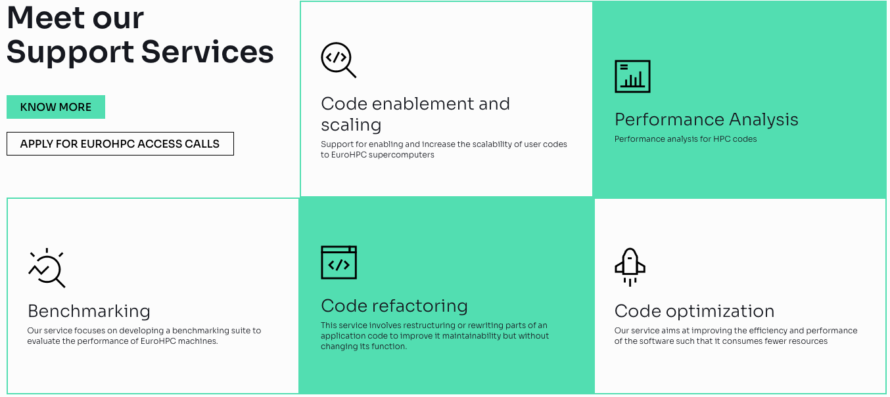
Support Services

Slide 13
Context
Mission
Main Goals
Expected Outcomes
Support Services
Access the Resources
Consortium

Slide 14
Access the Resources
Access to EuroHPC JU supercomputers through open calls¹
Regular, Extreme Scale, and AI/Data Intensive access typologies
Accepted projects are matched to adequate supercomputers
Access to EPICURE support for accepted projects
Users choose the level of support needed
A team of experts will work closely with users to achieve set goals
^{1.} https://eurohpc-ju.europa.eu/access-our-supercomputers/eurohpc-access-calls_en

Slide 15
Context
Mission
Main Goals
Expected Outcomes
Support Services
Access the Resources
Consortium

Slide 16
Consortium

